Slide 1

Algorithm design
&
problem solving

Slide 2
Program Development Life Cycle
Analysis
Design
Coding
Testing

Slide 3
Analysis
The analysis stage uses abstraction and decomposition tools to identify exactly what is required from the program.
keeps the key elements required for the solution to the problem and discards any unnecessary details and information that is not required.
Decomposition breaks down a complex problem into smaller parts, which can then be subdivided into even smaller parts, that can be solved easily.

Slide 4
2. Design
When the design stage is complete, the programmer should know what is to be done.
All the tasks that need to be completed
How each task is to be performed
How the tasks work together.
This can be formally documented using structure charts, flowcharts and pseudocode

Slide 5
3. Coding and Iterative Testing
Coding - The program or set of programs is developed. Each module of the program is written using a suitable programming language and then tested to see if it works.
Iterative Testing - Modular tests are conducted, code amended, and tests repeated until the module performs as required.

Slide 6
4. Testing
The completed program or set of programs is run many times with different sets of test data.
This ensures that all the tasks completed work together as specified in the program design.

Slide 7
Computer systems, sub-systems and decomposition
A computer system is made up of
Software
Data
Hardware
Communications
People
Each computer system can be divided up into a set of sub-systems.
Each sub-system can be further divided into sub-systems and so on until each sub-system just performs a single action.

Slide 8
Each sub-system can be developed by a programmer as a sub-routine.
How each sub-routine works can be shown by using flowcharts or pseudocode.

Slide 9
Top-down design
Decomposition of a computer system into a set of subsystems.
Breaking each sub-system down into a set of smaller sub-systems, until each sub-system just performs a single action.
The process of breaking down into smaller sub-systems is called stepwise refinement.

Slide 10
Any problem that uses a computer system for its solution needs to be decomposed into its component parts.
The component parts of any computer system are:
inputs – the data used by the system that needs to be entered while the system is active
processes – the tasks that need to be performed using the input data and any other previously stored data
outputs – information that needs to be displayed or printed for the users of the system
storage – data that needs to be stored in files on an appropriate medium for use in the future.

Slide 11
Solutions to problems need to be designed and developed rigorously.
The use of the following formal methods enables the process to be clearly shown for others to understand the proposed solution.
structure diagrams
flowcharts
pseudocode

Slide 12
Structure diagrams
To show top-down design in a diagrammatic form.
Structure diagrams are hierarchical, showing how a computer system solution can be divided into sub-systems with each level giving a more detailed breakdown.
If necessary, each sub-system can be further divided.

Slide 13
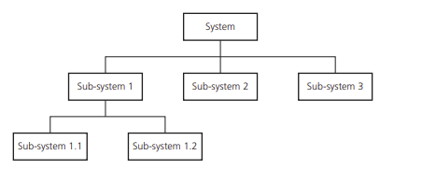
Basic structure diagram

Slide 14
Flowchart
A flowchart shows diagrammatically the steps required to complete a task and the order that they are to be performed.
These steps, together with the order, are called an algorithm.
Flowcharts are an effective way to communicate how the algorithm that makes up a system or sub-system works.
Flowcharts are drawn using standard flowchart symbols.

Slide 15
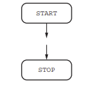
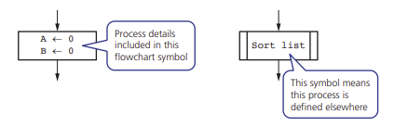
Begin/End
Terminator flowchart symbols are used at the beginning and end of each flowchart.
Process
Process flowchart symbols are used to show actions, for example, when values are assigned to variables. If a process has been defined elsewhere then the name of that process is shown.

Slide 16

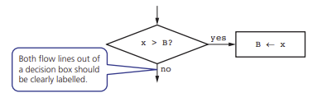
Input and output
This flowchart symbol is used to show the input of data and output of information.
Decision
Decision flowchart symbols are used to decide which action is to be taken next; these can be used for selection and repetition/iteration.
There are always two outputs from a decision flowchart symbol.

Slide 17
Flow lines
Flowchart flow lines use arrows to show the direction of flow, which is usually, but not always, top to bottom and left to right.

Slide 18

Pseudocode
Pseudocode is a simple method of showing an algorithm.
It describes what the algorithm does by using English key words that are very similar to those used in a high-level programming language.
Pseudocode is not bound by the strict syntax rules of a programming language.
Pseudocode for assignment statement:

Slide 19
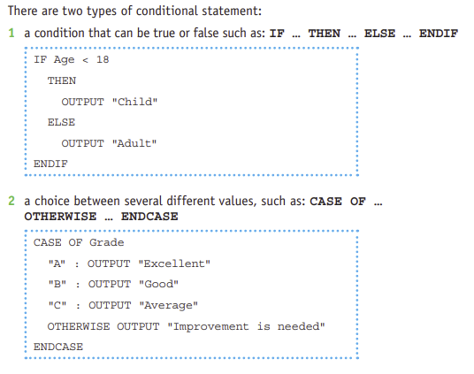
The pseudocode for conditional statements

Slide 20
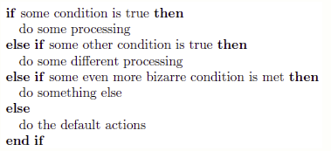
nested IF

Slide 21
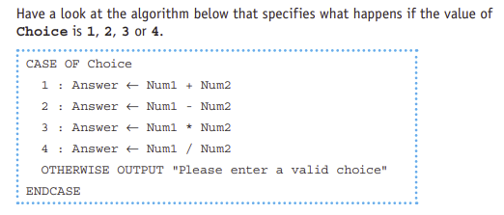
CASE OF … OTHERWISE … ENDCASE
For a CASE statement the value of the variable decides the path to be taken. Several values are usually specified.
OTHERWISE is the path taken for all other values.
The end of the statement is shown by ENDCASE.

Slide 22
The pseudocode for iteration
Loop structures are used to perform the iteration.
Pseudocode includes these three different types of loop structure:
A set number of repetitions FOR … TO … NEXT
A repetition,
where the number of repeats is
not known, that is completed at
least once REPEAT … UNTIL A repetition,
Where the number of repeats
is not known, that may never be
completed WHILE … DO … ENDWHILE

Slide 23
Standard methods of solution
Totalling
Counting
Finding maximum, minimum, and average (mean) values
Searching using a linear search
Sorting using a bubble sort.

Slide 24
Totalling - Keeping a total that values are added to.
Counting - Keeping a count of the number of times an action is performed is another standard method.
Maximum, minimum and average - Finding the largest and smallest values in a list are two standard methods that are frequently found in algorithms.
Linear search - Inspects each item in a list in turn to see if the item matches the value searched for.
Bubble sort
- Each element is compared with the next element and swapped if the elements are in the wrong order, starting from the first element and finishing with next-to-last element.
- Once it reaches the end of the list, we can be sure that the last element is now in the correct place.
- Each element in the list is compared again apart from the last one because we know the final element is in the correct place.
- This continues to repeat until there is only one element left to check or no swaps are made.

Slide 25
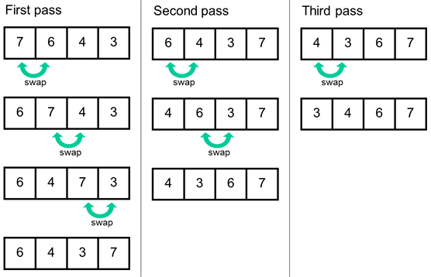
Bubble Sort

Slide 26
Validation & Verification
Validation is the automated checking by a program that data is reasonable before it is accepted into a computer system.
When data is validated by a computer system, if the data is rejected a message should be output explaining why the data was rejected and another opportunity given to enter the data.

Slide 27
There are many different types of validation checks including:
range checks
length checks
type checks
presence checks
format checks
check digits.

Slide 28
Verification
Verification is checking that data has been accurately copied from one source to another – for instance, input into a computer or transferred from one part of a computer system to another.
Verification methods for input data include:
Double entry
Screen/visual check

Slide 29
Test Data
In order to determine whether a solution is working as it should.
Usually before a whole system is tested each sub-system is tested separately.
A set of test data is all the items of data required to work through a solution.
Normal data - should be used to work through the solution to find the actual result(s) and see if they are the same as the expected result(s).
Abnormal test data - Solutions also need to be tested to prove that they do not do what they are supposed not to do. Test data should be chosen that would be rejected by the solution as not suitable, if the solution is working properly. (It is also sometimes called erroneous test data.)

Slide 30
Extreme data - Extreme data are the largest and smallest values that normal data can take.
Boundary data - This is used to establish where the largest and smallest values occur. At each boundary two values are required: one value is accepted and the other value is rejected.
Trace Tables
Used to record the results from each step in an algorithm.
It is used to record the value of an item (variable) each time that it changes.
The manual exercise of working through an algorithm step by step is called a dry run.
Trace tables and test data can be used to identify and correct errors.

Slide 31
Writing and Amending Algorithms
Clearly specified problem.
Break the problem down in to sub-problems.
Decide on how any data is to be obtained and stored, what is going to happen to the data and how any results are going to be displayed.
Design the structure of your algorithm using a structure diagram.
Decide on how you are going to construct your algorithm - a flowchart or pseudocode.
Construct an easily readable algorithm.
Dry run your algorithm, show the results in trace tables.
Correct errors and repeat.

Slide 32
Quiz - https://forms.gle/t5E6o3ThkU3rGmrCA

